Slide 1
What is Object-oriented Programming?
By: Iman Khani Jazani
AI and Data Specialist, Business Developer | AiHum
Adjunct Professor | Sharif University of Technology
Senior Data Scientist, Community builder | Adin

Slide 2
Last Lecture
Short Presentations
Review the last lecture
Review in OOP examples
How to implement in Python?
Application of Programming in the Digital Age!

Slide 3
Today
Short Presentations
Review OOP with examples
Our futuristic library
Application of Programming in the Digital Age!

Slide 4
Together
Send your feedback about the class whenever you want!

Slide 5
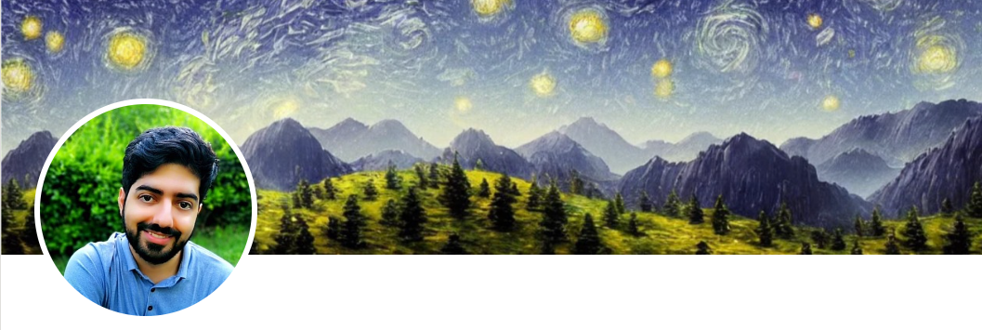
Contact me
Gmail: ImanKhaniJazani@gmail.com
LinkedIn: https://www.linkedin.com/in/ImanKhaniJazani/
Telegram: @IKJ1992

Slide 6
Short Presentations

Slide 7
Review OOP with examples

Slide 8

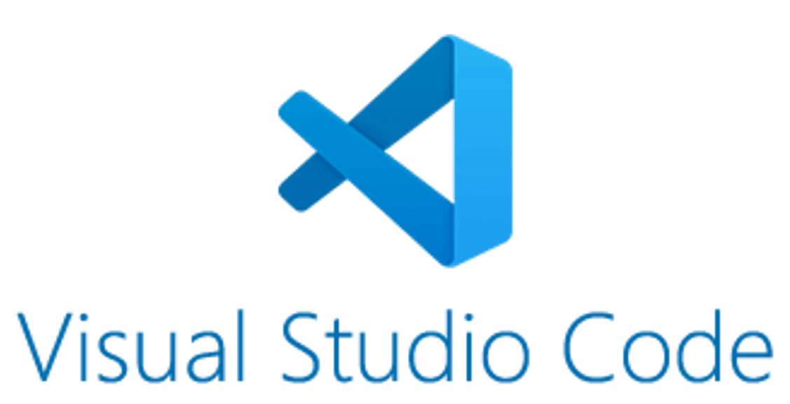
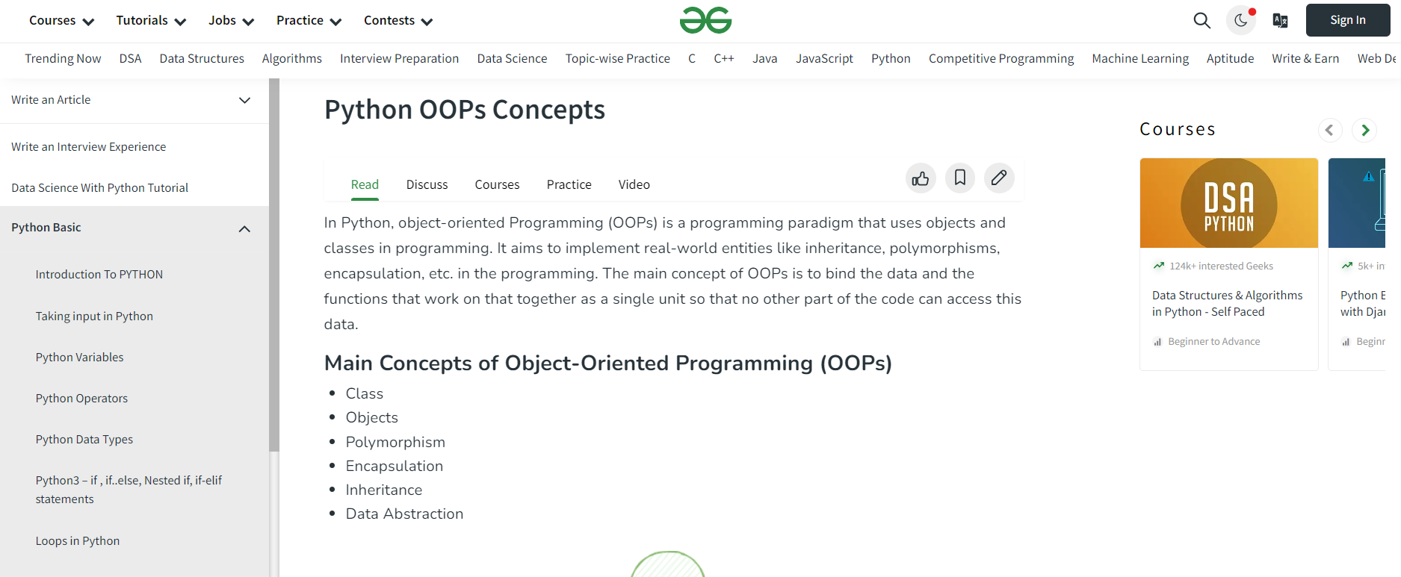
Let’s read it!
Notes:
https://www.geeksforgeeks.org/python-oops-concepts/

Slide 9
Our futuristic library!

Slide 10


Our library 😉

Slide 11
List of new features
Build our lib
Add search and sort for our book
Add Shakhs class for parent class of Ketabkhoon

Slide 12
Application of Programming in the Digital Age!

Slide 13
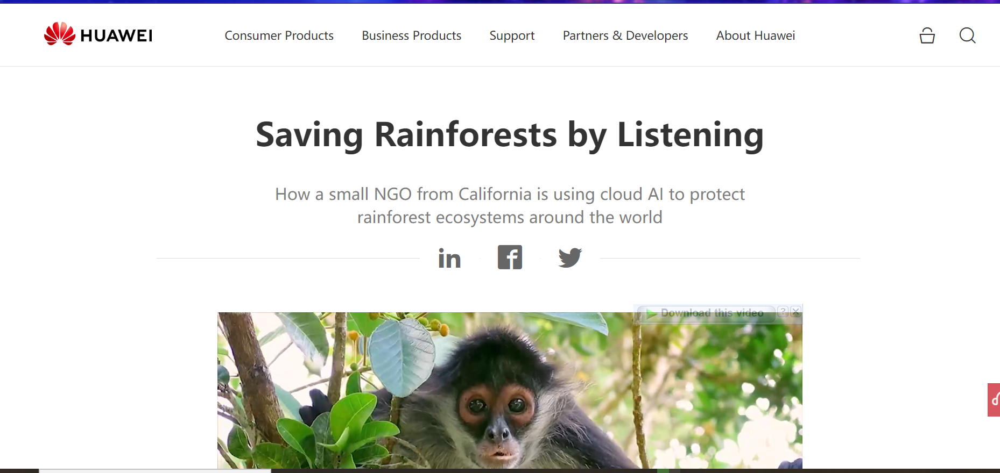
HUAWEI for nature!
Notes:
https://www.huawei.com/en/tech4all/stories/rainforest

Slide 14
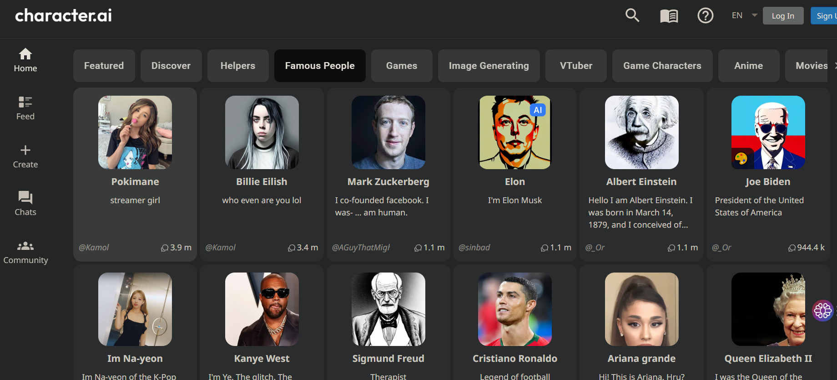
یادتونه ازش تعریف کرده بودم؟

Slide 15
Lecture Resources
https://realpython.com/python3-object-oriented-programming/
https://www.freecodecamp.org/news/object-oriented-programming-in-python/#:~:text=All%20four%20core%20aspects%20of,get%20some%20practice%20with%20them.
https://www.geeksforgeeks.org/python-oops-concepts/
https://www.programiz.com/python-programming/object-oriented-programming

